Slide 1

RL Novels
n-step Bootstrapping
Giovanni GATTI PINHEIRO
October, 11th 2019
AIR-REV-DPI-MLS

Slide 2
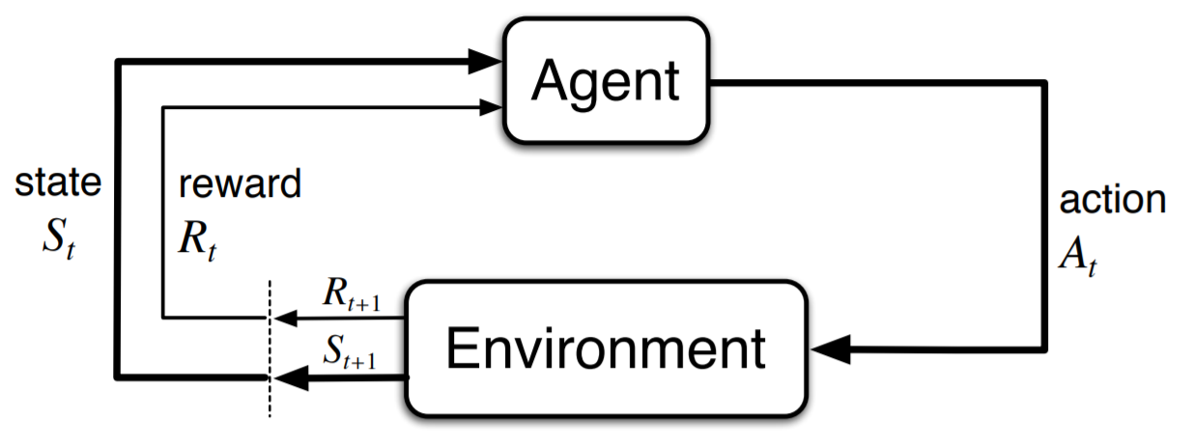
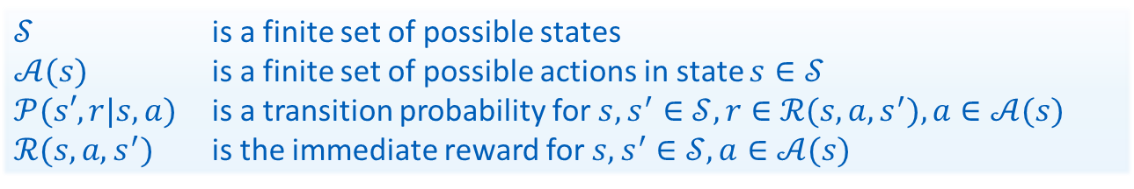
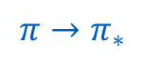
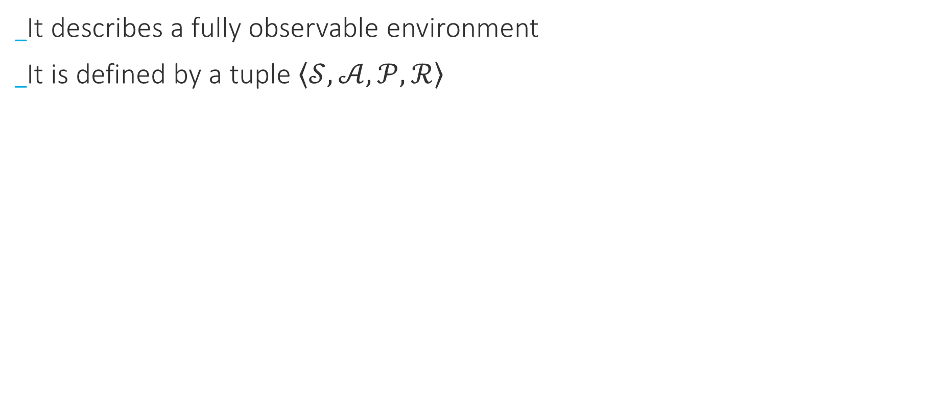
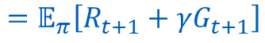
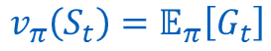
Review
Markov Decision Process
It describes a fully observable environment
It is defined by a tuple $\left\langle 𝒮, 𝒜, 𝒫,ℛ\right\rangle$
$$π→π_{∗}$$
Goal:
$$v_{π}\left(S_{t}\right)=𝔼_{π}\left[G_{t}\right]$$
$$=𝔼_{π}\left[R_{t+1}+γG_{t+1}\right]$$
$𝒮$ is a finite set of possible states
$𝒜(s)$ is a finite set of possible actions in state $s∈𝒮$
$𝒫(s′,r|s, a)$ is a transition probability for$s, s^{′}∈𝒮, r∈ℛ(s, a, s^{′}), a∈𝒜(s)$
$ℛ(s, a, s^{′})$ is the immediate reward for$s, s^{′}∈𝒮, a∈𝒜(s)$

Slide 3
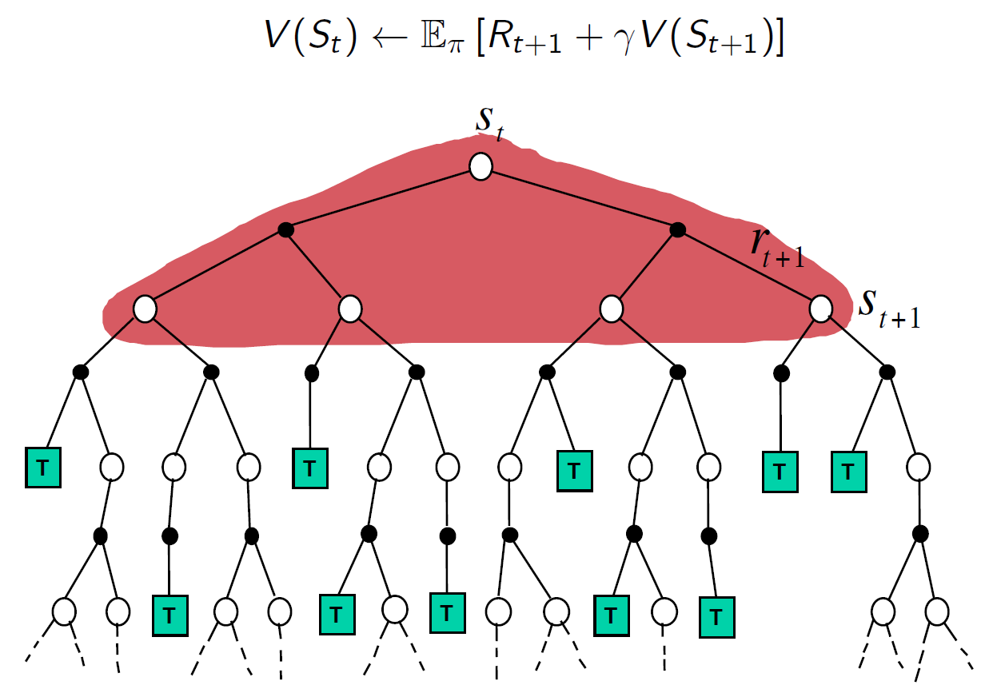
Review
Dynamic Programming
Infeasible for large state-spaces (curse of dimensionality)
model-based approach

Slide 4
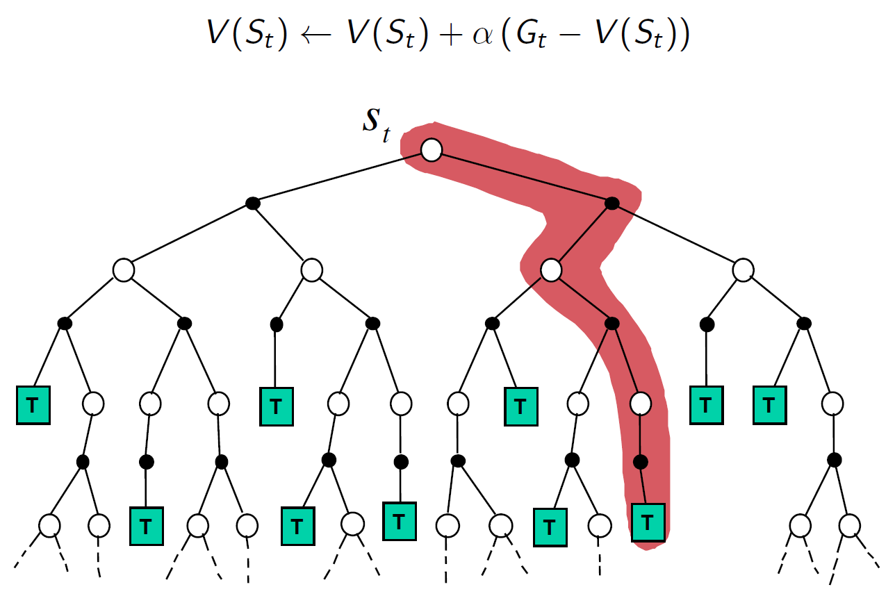
Review
Monte-Carlo methods
model-free approach
(side bonus) agent can focus on states that he is actually experiencing

Slide 5
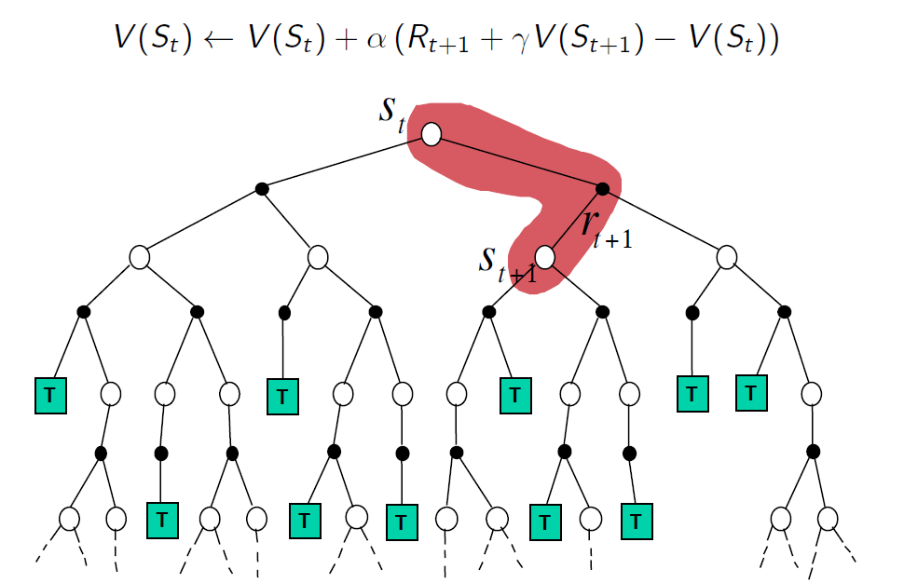
Review
TD-Learning
model-free approach, like MC
Bootstrapping, like DP
Lower variance (over state-values)
Learning can start before the end of an episode
Can be applied to continuous tasks
Tyranny of the time step

Slide 6
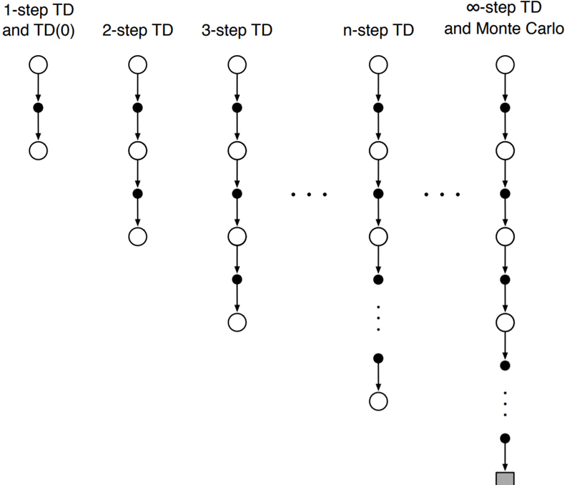
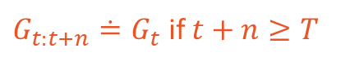
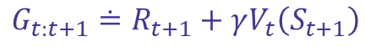
n-step Prediction
Intuition
What is the space of methods lying between Monte-Carlo and TD methods?
MC return:
$$G_{t}≐R_{t+1}+γR_{t+2}+γ^{2}R_{t+3}+⋯+γ^{T−t−1}R_{T}$$
TD return:
$$G_{t:t+1}≐R_{t+1}+γV_{t}\left(S_{t+1}\right)$$
Two step TD return:
$$G_{t:t+2}≐R_{t+1}+{γR}_{t+2}+γ^{2}V_{t+1}\left(S_{t+2}\right)$$
n-step TD return:
$$G_{t:t+n}≐R_{t+1}+{γR}_{t+2}+⋯+γ^{n−1}{R_{t+n}+γ^{n}V}_{t+n−1}\left(S_{t+n}\right)$$
$G_{t:t+n}≐G_{t}$ if $t+n≥T$
State-value function using n-step TD return:
$$V_{t+n}\left(S_{t}\right)≐V_{t+n−1}\left(S_{t}\right)+α\left[G_{t:t+n}−V_{t+n−1}\left(S_{t}\right)\right]$$

Slide 7
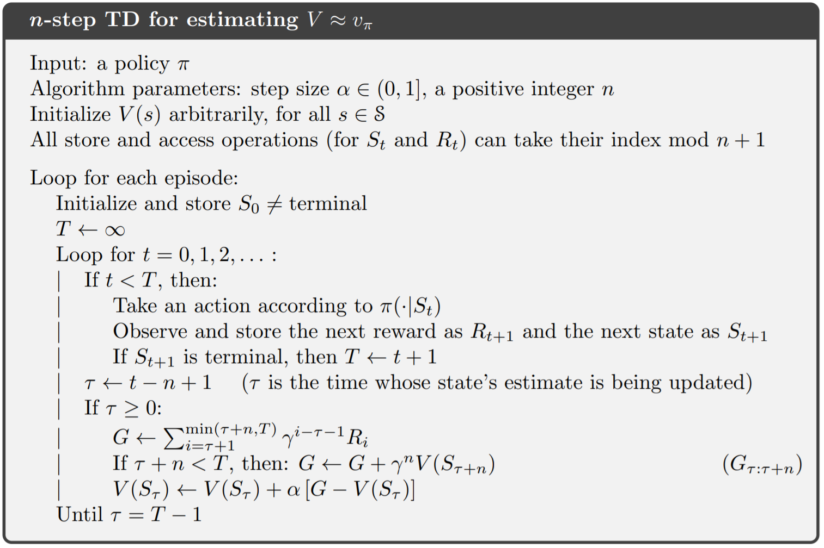

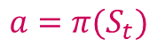
n-step Prediction
$$S_{t}$$
n-step TD Algorithm
$$a=π(S_{t})$$

Slide 8
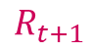
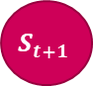
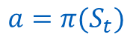
n-step Prediction
$$S_{t}$$
n-step TD Algorithm
$$a=π(S_{t})$$
$$R_{t+1}$$
$$S_{t+1}$$

Slide 9
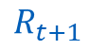
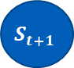
n-step Prediction
$$S_{t}$$
n-step TD Algorithm
$$a=π(S_{t})$$
$$R_{t+1}$$
$$S_{t+1}$$

Slide 10
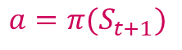
n-step Prediction
$$S_{t}$$
n-step TD Algorithm
$$a=π(S_{t})$$
$$R_{t+1}$$
$$S_{t+1}$$
$$a=π(S_{t+1})$$

Slide 11
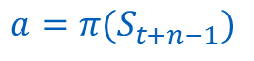
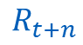
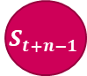
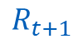
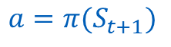
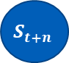

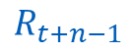
n-step Prediction
$$S_{t}$$
n-step TD Algorithm
$$a=π(S_{t})$$
$$R_{t+1}$$
$$S_{t+1}$$
$$a=π(S_{t+1})$$
$$R_{t+1}$$
$$⋯$$
$$R_{t+n−1}$$
$$S_{t+n−1}$$
$$a=π(S_{t+n−1})$$
$$R_{t+n}$$
$$S_{t+n}$$

Slide 12
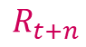
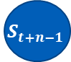
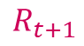
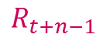
n-step Prediction
$$S_{t}$$
n-step TD Algorithm
$$a=π(S_{t})$$
$$R_{t+1}$$
$$S_{t+1}$$
$$a=π(S_{t+1})$$
$$R_{t+1}$$
$$⋯$$
$$R_{t+n−1}$$
$$S_{t+n−1}$$
$$a=π(S_{t+n−1})$$
$$R_{t+n}$$
$$S_{t+n}$$

Slide 13
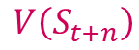
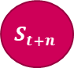
n-step Prediction
$$S_{t}$$
n-step TD Algorithm
$$a=π(S_{t})$$
$$R_{t+1}$$
$$S_{t+1}$$
$$a=π(S_{t+1})$$
$$R_{t+1}$$
$$⋯$$
$$R_{t+n−1}$$
$$S_{t+n−1}$$
$$a=π(S_{t+n−1})$$
$$R_{t+n}$$
$$S_{t+n}$$
$$V\left(S_{t+n}\right)$$

Slide 14
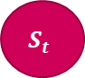
n-step Prediction
$$S_{t}$$
$$V\left(S_{t}\right)=V\left(S_{t}\right)+α\left[G−V\left(S_{t+n}\right)\right]$$
n-step TD Algorithm
$$a=π(S_{t})$$
$$R_{t+1}$$
$$S_{t+1}$$
$$a=π(S_{t+1})$$
$$R_{t+1}$$
$$⋯$$
$$R_{t+n−1}$$
$$S_{t+n−1}$$
$$a=π(S_{t+n−1})$$
$$R_{t+n}$$
$$S_{t+n}$$

Slide 15

n-step Prediction
$$S_{t}$$
n-step TD Algorithm
$$a=π(S_{t})$$
$$R_{t+1}$$
$$S_{t+1}$$
$$a=π(S_{t+1})$$
$$R_{t+1}$$
$$⋯$$
$$R_{t+n−1}$$
$$S_{t+n−1}$$
$$a=π(S_{t+n−1})$$
$$R_{t+n}$$
$$S_{t+n}$$
$$⋯$$
T

Slide 16
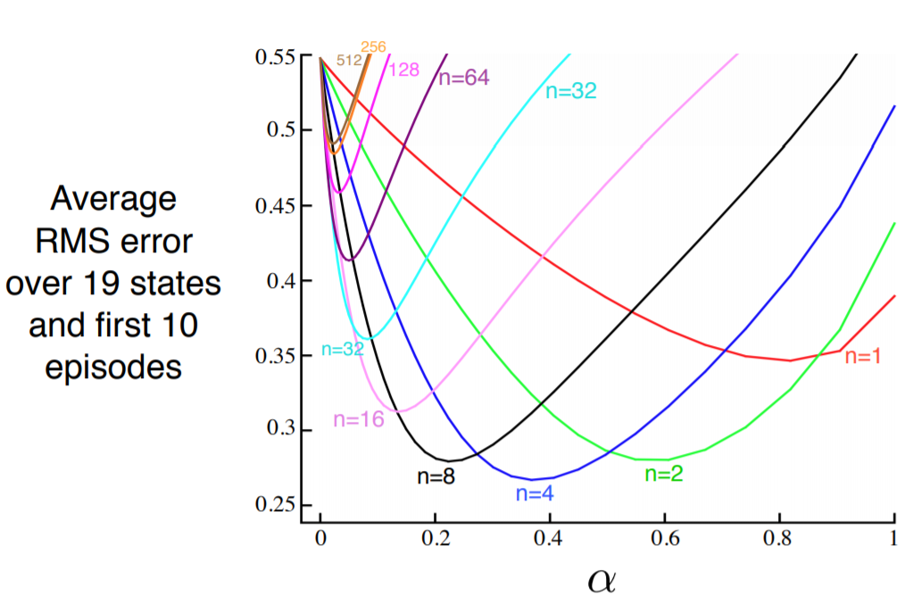






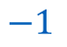

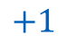
n-step Prediction
Random Walk Example
$$−1$$
A
$$0$$
B
$$0$$
$$⋯$$
$$0$$
J
$$0$$
$$⋯$$
$$0$$
R
$$0$$
S
$$+1$$
Markov Reward Process
19 non-terminal states
Episodes starts always from center state J

Slide 17
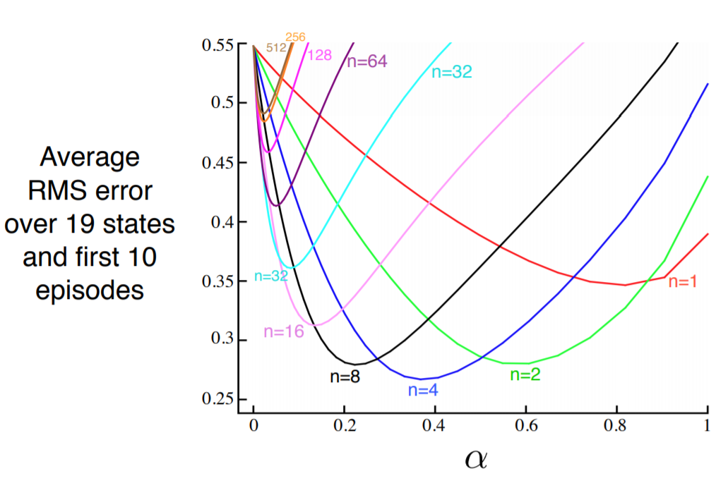
n-step Prediction
Random Walk Example
$$−1$$
A
$$0$$
B
$$0$$
$$⋯$$
$$0$$
J
$$0$$
$$⋯$$
$$0$$
R
$$0$$
S
$$+1$$
In last session, we’ve used a 5-states random walk example.
Why making it larger here? Would a smaller shifted the advantage to a different value of n?

Slide 18
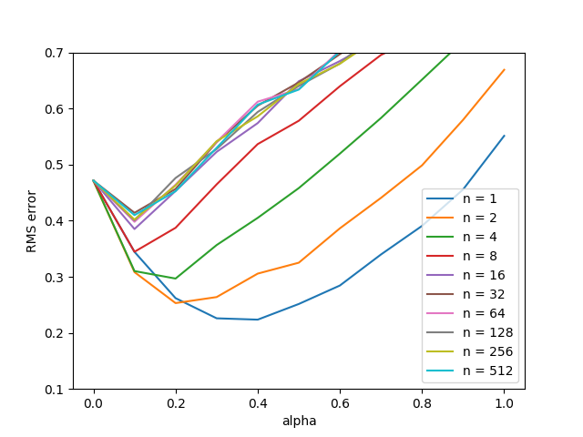
n-step Prediction
Random Walk Example
$$−1$$
A
$$0$$
B
$$0$$
$$⋯$$
$$0$$
J
$$0$$
$$⋯$$
$$0$$
R
$$0$$
S
$$+1$$
5-state random walk
Why making it larger here? Would a smaller shifted the advantage to a different value of n?
As episodes aren’t long in the five-state random walk problem (~ 9 transitions/episode), large values of n will behave exactly as MC. If fact, with such setting, there is little to gain from n-step bootstrapping, since variance increases with n forcing learning rate must be smaller.

Slide 19
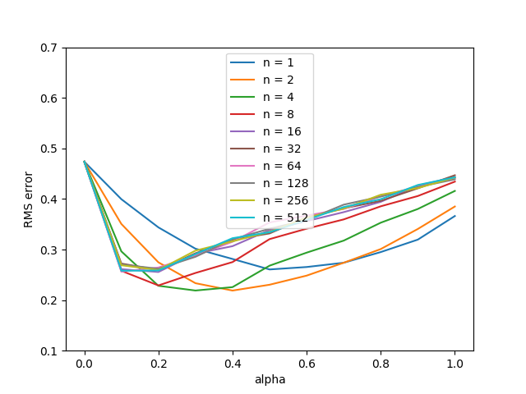

n-step Prediction
Random Walk Example
$$0$$
A
$$0$$
B
$$0$$
$$⋯$$
$$0$$
J
$$0$$
$$⋯$$
$$0$$
R
$$0$$
S
$$+1$$
5-state random walk, with left side return set to 0
How about the change in the left side outcome from 0 to -1?
Updates must come from only from the right side, which means that it can take long to update the value of left most states. In this case, n-step bootstrapping breaks the tyranny of one-time step, letting updates get quicker to this far-away states.

Slide 20
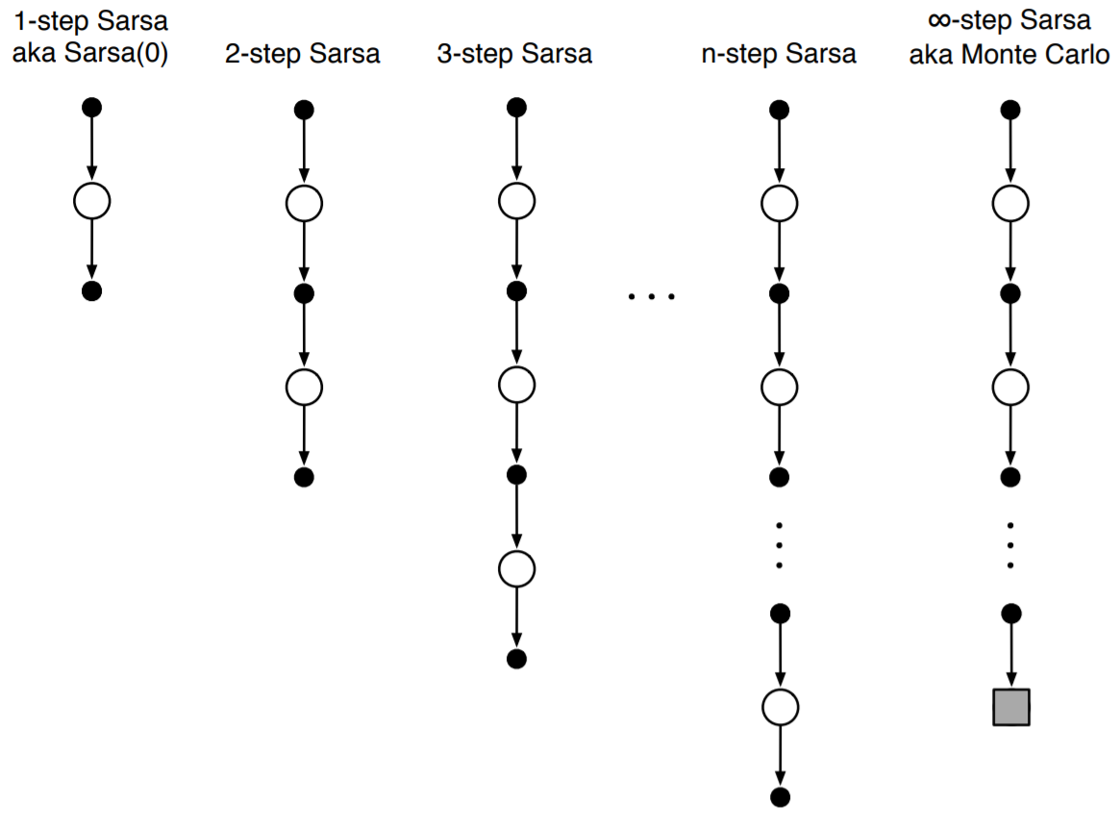
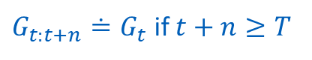
n-step Control
n-step Sarsa
n-step TD return:
$$G_{t:t+n}≐R_{t+1}+{γR}_{t+2}+⋯+γ^{n−1}{R_{t+n}+γ^{n}V}_{t+n−1}\left(S_{t+n}\right)$$
$G_{t:t+n}≐G_{t}$ if $t+n≥T$
$$G_{t:t+n}≐R_{t+1}+{γR}_{t+2}+⋯+γ^{n−1}{R_{t+n}+γ^{n}Q}_{t+n−1}\left(S_{t+n},A_{t+n}\right)$$
State-value function using n-step TD return:
$$V_{t+n}\left(S_{t}\right)≐V_{t+n−1}\left(S_{t}\right)+α\left[G_{t:t+n}−V_{t+n−1}\left(S_{t}\right)\right]$$
$$Q_{t+n}\left(S_{t},A_{t}\right)≐Q_{t+n−1}\left(S_{t},A_{t}\right)+α\left[G_{t:t+n}−Q_{t+n−1}\left(S_{t},A_{t}\right)\right]$$

Slide 21
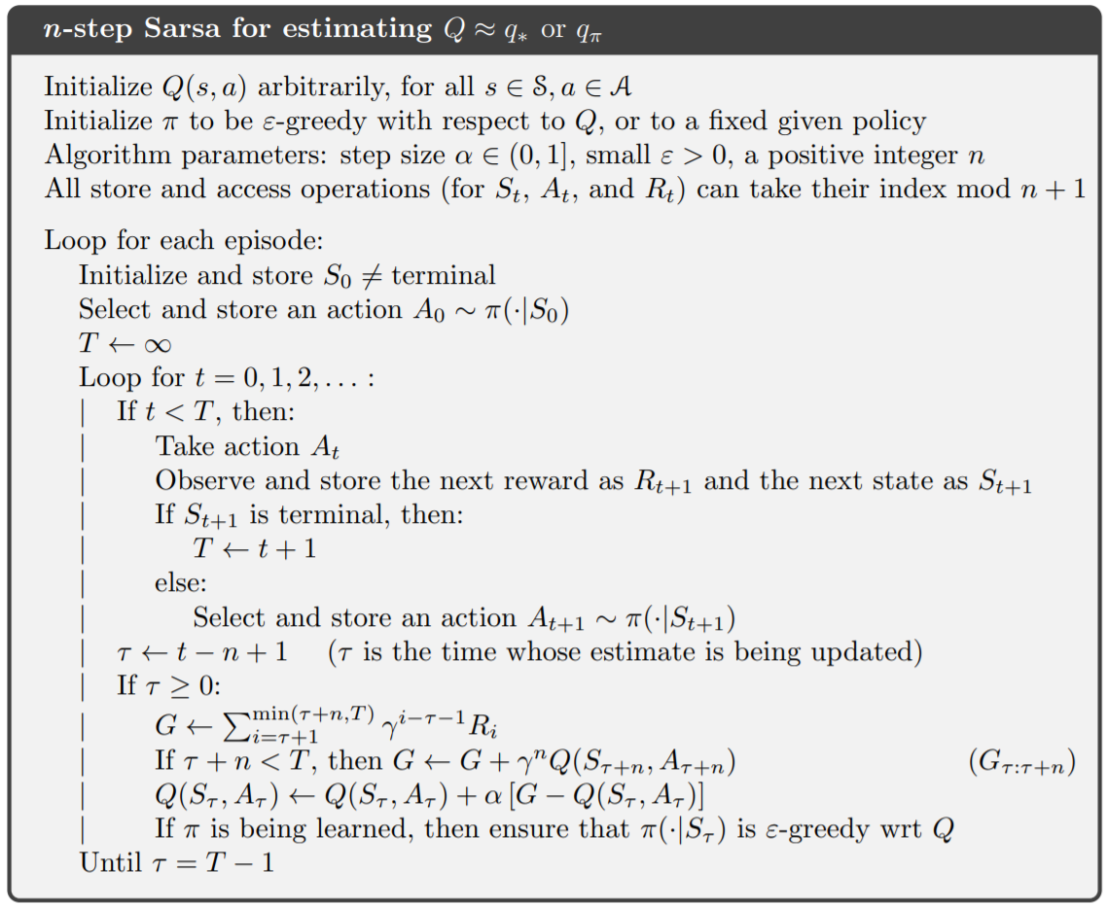
n-step Control
n-step Sarsa
A
R
S
S’
S’
S’
A
R
A’

Slide 22
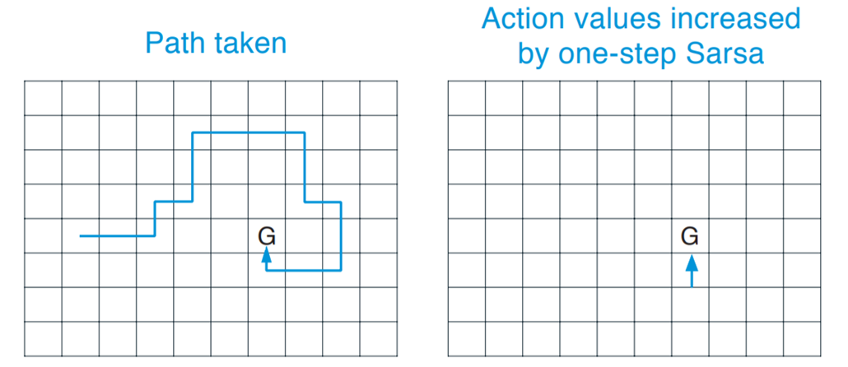
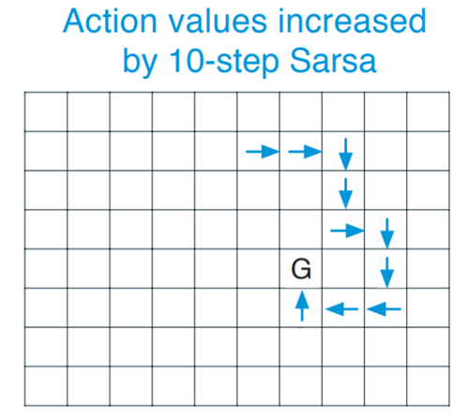

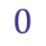

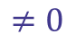
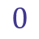
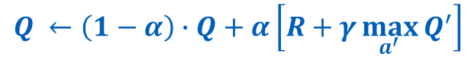

n-step Control
$$Q ←\left(1−α\right)∙Q+α\left[R+γ\max_{a^{′}}{Q^{′}}\right]$$
$$0$$
$$≠0$$
$$0$$
$$0$$
$$0$$
$$0$$
Gridworld example
All rewards are zero, except by a positive reward at G
Arrows show which actions were strengthened as a result of the path taken (after a single episode)
Q-Learning is limited by the tyranny of one-time step
n-step bootstrapping strengthens the last n actions of sequence, so that much more is learned from one episode

Slide 23
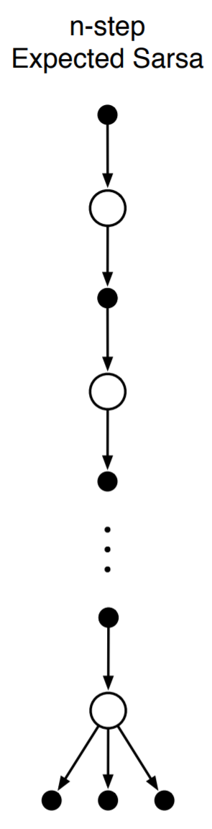

n-step Control
Expected Sarsa
What about Expected Sarsa? What would look like backup-diagram for this case?
How would be defined its n-step return?
$$G_{t:t+n}≐R_{t+1}+⋯+γ^{n−1}{R_{t+n}+γ^{n}\overline{V}}_{t+n−1}\left(S_{t+n}\right)$$
$${\overline{V}}_{t+n−1}\left(S_{t+n}\right)≐\sum_{a}{π\left(a|s\right)Q_{t}\left(s,a\right)}$$
Expected approx. value

Slide 24

n-step Control
n-step Expected Sarsa
Expected
How do we modify original n-step Sarsa algorithm to make it n-step Expected Sarsa?
$${\overline{V}}_{t+n−1}\left(S_{τ+n}\right)$$

Slide 25














n-step Off-policy Learning
n-step TD/Sarsa
$$S_{t}$$
$$A_{t}$$
$$R_{t+1}$$
$$S_{t+1}$$
$$A_{t+1}$$
$$R_{t+2}$$
$$S_{t+2}$$
$$A_{t+2}$$
$$R_{t+3}$$
$$S_{t+3}$$
$$b(A_{t}|S_{t})$$
$$b(A_{t+1}|S_{t+1})$$
$$b(A_{t+2}|S_{t+2})$$
Recall that off-policy learning is learning the value function for one policy $π$, while following another policy $b$.
The relative probability of seeing the behavior’s trajectory under the target policy is given by the importance sampling ratio, defined as
$$ρ_{t:h}≐\prod_{k=t}^{min⁡(h, T−1)}{\frac{π\left(A_{k}|S_{k}\right)}{b\left(A_{k}|S_{k}\right)}}$$
From MC talk!

Slide 26

n-step Off-policy Learning
n-step TD/Sarsa
$$S_{t}$$
$$A_{t}$$
$$R_{t+1}$$
$$S_{t+1}$$
$$A_{t+1}$$
$$R_{t+2}$$
$$S_{t+2}$$
$$A_{t+2}$$
$$R_{t+3}$$
$$S_{t+3}$$
$$b(A_{t}|S_{t})$$
$$b(A_{t+1}|S_{t+1})$$
$$b(A_{t+2}|S_{t+2})$$
Then the n-step TD update equation is
$$V_{t+n}\left(S_{t}\right)≐V_{t+n−1}\left(S_{t}\right)+αρ_{t:t+n−1}\left[G_{t:t+n}−V_{t+n−1}\left(S_{t}\right)\right]$$
Similarly, the n-step off-policy Sarsa update equation is
$$Q_{t+n}\left(S_{t},A_{t}\right)≐Q_{t+n−1}\left(S_{t},A_{t}\right)+αρ_{t:t+n−1}\left[G_{t:t+n}−Q_{t+n−1}\left(S_{t},A_{t}\right)\right]$$

Slide 27


n-step Off-policy Learning
n-step TD/Sarsa
$$ρ_{τ+1:τ+n}$$

Slide 28


n-step Off-policy Learning
n-step TD/Sarsa
Expected
What about Expected Sarsa?
$$ρ_{τ+1:τ+n−1}$$
$${\overline{V}}_{t+n−1}\left(S_{τ+n}\right)$$

Slide 29

n-step Off-policy Learning
Per-decision Methods with Control Variates
$$Q←Q+αρ_{t:t+n−1}\left[G_{t:t+n}−Q\right]$$
$$ρ_{t:h}≐\prod_{k=t}^{\min\left(h, T−1\right)}{ρ_{k}}=\prod_{k=t}^{min⁡(h, T−1)}{\frac{π\left(A_{k}|S_{k}\right)}{b\left(A_{k}|S_{k}\right)}}$$
Let’s say that $ρ_{t}=1,ρ_{t+1}=1,ρ_{t+2}=0$
Then, $ρ_{t:t+n}=0$
Because one action took by the behavior policy is would never be taken by the target policy, then trajectory is “discarded” and no learning is made from this experience

Slide 30



n-step Off-policy Learning
Per-decision Methods with Control Variates
Let’s say that target policy $π$ is an deterministic policy and that $π\left(A_{t+2}|S_{t+2}\right)=1$, so which is probability that action $A_{t+2}$is taken over the behavior policy $b$?
$$Q←Q+αρ_{t:t+n−1}\left[G_{t:t+n}−Q\right]$$
$$ρ_{t:h}≐\prod_{k=t}^{\min\left(h, T−1\right)}{ρ_{k}}=\prod_{k=t}^{min⁡(h, T−1)}{\frac{π\left(A_{k}|S_{k}\right)}{b\left(A_{k}|S_{k}\right)}}$$
Let’s say that $ρ_{t}=1,ρ_{t+1}=1,ρ_{t+2}=1.5$
Then, $ρ_{t:t+n}=1.5$
If one transition is more much more likely under the behavior policy than the target policy, then error variance can be large, requiring low learning rates to stabilize learning.
$$ρ_{t+2}=\frac{π\left(A_{t+2}|S_{t+2}\right)}{b\left(A_{t+2}|S_{t+2}\right)}⟺ \\ 1.5=\frac{1}{b\left(A_{t+2}|S_{t+2}\right)}⟺ \\ b\left(A_{t+2}|S_{t+2}\right)=2/3$$

Slide 31

n-step Off-policy Learning
Per-decision Methods with Control Variates
$$Q←Q+αρ_{t:t+n−1}\left[G_{t:t+n}−Q\right]$$
$$ρ_{t:h}≐\prod_{k=t}^{\min\left(h, T−1\right)}{ρ_{k}}=\prod_{k=t}^{min⁡(h, T−1)}{\frac{π\left(A_{k}|S_{k}\right)}{b\left(A_{k}|S_{k}\right)}}$$
High variance and trajectory “discarding” may make learning very inefficient

Slide 32

n-step Off-policy Learning
Per-decision Methods with Control Variates
$$Q←Q+αρ_{t:t+n−1}\left[G_{t:t+n}−Q\right]$$
$$ρ_{t:h}≐\prod_{k=t}^{\min\left(h, T−1\right)}{ρ_{k}}=\prod_{k=t}^{min⁡(h, T−1)}{\frac{π\left(A_{k}|S_{k}\right)}{b\left(A_{k}|S_{k}\right)}}$$
To fix it, we can use then an alternate definition for the n-step return
$$G_{t:h}≐R_{t+1}+γG_{t+1:h}$$
$$G_{t:h}≐ρ_{t}\left(R_{t+1}+γG_{t+1:h}\right)+\left(1−ρ_{t}\right)V_{h−1}\left(S_{t}\right)$$
Per decision importance-sampling
Control-Variate

Slide 33




n-step Off-policy Learning
Per-decision Methods with Control Variates
Back to $ρ_{t}=1,ρ_{t+1}=1,ρ_{t+2}=0$ example….
$$G_{t:h}≐ρ_{t}\left(R_{t+1}+γG_{t+1:h}\right)+\left(1−ρ_{t}\right)V_{h−1}\left(S_{t}\right) \\ =R_{t+1}+γG_{t+1:h} \\ =R_{t+1}+γ\left[ρ_{t+1}\left(R_{t+2}+γG_{t+2:h}\right)+\left(1−ρ_{t+1}\right)V_{h−1}\left(S_{t+1}\right)\right] \\ =R_{t+1}+γ\left(R_{t+2}+γG_{t+2:h}\right) \\ =R_{t+1}+γ\left(R_{t+2}+γ\left[ρ_{t+2}\left(R_{t+3}+γG_{t+3:h}\right)+\left(1−ρ_{t+2}\right)V_{h−1}\left(S_{t+2}\right)\right]\right)=R_{t+1}+γ\left(R_{t+2}+γ\left[V_{h−1}\left(S_{t+2}\right)\right]\right) \\ =R_{t+1}+γR_{t+2}+γ^{2}V_{h−1}\left(S_{t+2}\right)$$
$$=0$$
$$=0$$
$$=0$$
Decision tree is “cut” down to the longest path possible

Slide 34

n-step Off-policy Learning
Per-decision Methods with Control Variates
Considering the other example $ρ_{t}=1,ρ_{t+1}=1,ρ_{t+2}=1.5$ example….
$$G_{t:h}≐ρ_{t}\left(R_{t+1}+γG_{t+1:h}\right)+\left(1−ρ_{t}\right)V_{h−1}\left(S_{t}\right) \\ =⋯ \\ =R_{t+1}+γ\left(R_{t+2}+γ\left[ρ_{t+2}\left(R_{t+3}+γG_{t+3:h}\right)+\left(1−ρ_{t+2}\right)V_{h−1}\left(S_{t+2}\right)\right]\right) \\ =R_{t+1}+γR_{t+2}+γ^{2}\left[1.5∙\left(R_{t+3}+γG_{t+3:h}\right)−.5∙V_{h−1}\left(S_{t+2}\right)\right]$$
$$=0$$
Lower
Variance

Slide 35


n-step Off-policy Learning
Per-decision Methods with Control Variates
But can we simply do that?! Does that change the expected value of the total return?
$$v_{π}\left(S_{t}\right)≐𝔼_{π}\left[G_{t:h}\right] \\ =𝔼_{π}\left[ρ_{t}\left(R_{t+1}+γG_{t+1:h}\right)+\left(1−ρ_{t}\right)V_{h−1}\left(S_{t}\right)\right] \\ =𝔼_{π}\left[ρ_{t}\left(R_{t+1}+γG_{t+1:h}\right)\right]+𝔼_{π}\left[V_{h−1}\left(S_{t}\right)\right]−𝔼_{π}\left[ρ_{t}V_{h−1}\left(S_{t}\right)\right] \\ =ρ_{t}𝔼_{π}\left[R_{t+1}+γG_{t+1:h}\right]+v_{π}\left(S_{t}\right)−ρ_{t}∙v_{π}\left(S_{t}\right) \\ =v_{π}\left(S_{t}\right)−ρ_{t}\left(𝔼_{π}\left[R_{t+1}+γG_{t+1:h}\right]−v_{π}\left(S_{t}\right)\right) \\ =v_{π}\left(S_{t}\right)−ρ_{t}\left(v_{π}\left(S_{t}\right)−v_{π}\left(S_{t}\right)\right) \\ =v_{π}\left(S_{t}\right)$$
$$𝔼_{π}\left[ρ_{t}\right]=𝔼_{π}\left[\frac{π(A_{t}|S_{t})}{b(A_{t}|S_{t})}\right] \\ =\frac{1}{b(A_{t}|S_{t})}𝔼_{π}\left[π(A_{t}|S_{t})\right] \\ =\frac{π(A_{t}|S_{t})}{b(A_{t}|S_{t})} \\ =ρ_{t}$$
(constant scalar)

Slide 36


n-step Off-policy Learning
Per-decision Methods with Control Variates
Recall:
$${\overline{V}}_{h−1}\left(S_{t+1}\right)=\sum_{a}{π\left(a|S_{t+1}\right)Q_{h−1}\left(S_{t+1},a\right)}$$
Applying it to off-policy control gives us
$$G_{t:h}≐ρ_{t}\left(R_{t+1}+γG_{t+1:h}\right)+\left(1−ρ_{t}\right)V_{h−1}\left(S_{t}\right) \\ =ρ_{t}\left(R_{t+1}+γG_{t+1:h}−V_{h−1}\left(S_{t}\right)\right)+V_{h−1}\left(S_{t}\right)$$
$$G_{t:h}≐R_{t+1}+γρ_{t+1}\left(G_{t+1:h}−Q_{h−1}\left(S_{t+1},A_{t+1}\right)\right)+γ{\overline{V}}_{h−1}\left(S_{t+1}\right)$$
Remember that first action does not take a role in importance sampling (it is the one being learned, it doesn’t matter if it was impossible under the target policy).

Slide 37


n-step Off-policy Learning
Control Variates on 19-state Random Walk example
$$−1$$
A
$$0$$
B
$$0$$
$$⋯$$
$$0$$
J
$$0$$
$$⋯$$
$$0$$
R
$$0$$
S
$$+1$$
$$b\left(a|s\right)=.5, ∀s,a$$
$$π\left(right|s\right)=.7, ∀s$$
Average RMS error over 19 states and first 60 episodes

Slide 38


n-step Off-policy Learning
n-step Tree Backup Algorithm
Is off-policy learning possible without importance sampling?
As we don’t have sample data to unselected actions, we bootstrap them and use estimates of their values in forming the target for the update
$$G_{t:t+n}≐R_{t+1}+ \\ γ\sum_{a≠A_{t+1}}{π\left(a|S_{t+1}\right)}Q_{t+n−1}\left(S_{t+1},a\right)+ \\ γπ\left(A_{t+1}|S_{t+1}\right)G_{t+1:t+n}$$
$$Q_{t+n}\left(S_{t},A_{t}\right)≐Q_{t+n−1}\left(S_{t},A_{t}\right)+α\left[G_{t:t+n}−Q_{t+n−1}\left(S_{t},A_{t}\right)\right]$$

Slide 39

n-step Off-policy Learning
A Unifying Algorithm: n-step Q(σ)
n-step Sarsa has all sample transitions
Tree Backup algorithm has all state-to-action transitions fully branched without sampling
n-step Expected Sarsa has all sample transitions expect for the last state-to-action one, which is fully branched
To what extend can this algorithms be unified?

Slide 40


n-step Off-policy Learning
A Unifying Algorithm: n-step Q(σ)
One idea to unify all those algorithms is presented as n-step Q(σ)
We decide on a step-basis whether we want to take the action sample, as in Sarsa, or consider the expectation over all actions instead, as in the tree backup-algoritm
$σ∈\left[0, 1\right]$ denotes the degree of sampling, with $σ=1$ being the full sampling and $σ=0$ denoting a pure expectation
$$G_{t:h}≐R_{t+1}+ \\ γ\left(σ_{t+1}ρ_{t+1}+\left(1−σ_{t+1}\right)π\left(A_{t+1}|S_{t+1}\right)\right)\left(G_{t+1:h}−Q_{h−1}\left(S_{t+1},A_{t+1}\right)\right)+ \\ γ{\overline{V}}_{h−1}\left(S_{t+1}\right)$$
Like Tree-Back up algorithm
Like n-step Sarsa

Slide 41

n-step Off-policy Learning
A Unifying Algorithm: n-step Q(σ)
$$G_{t:h}≐R_{t+1}+ \\ γ\left(σ_{t+1}ρ_{t+1}+\left(1−σ_{t+1}\right)π\left(A_{t+1}|S_{t+1}\right)\right)\left(G_{t+1:h}−Q_{h−1}\left(S_{t+1},A_{t+1}\right)\right)+ \\ γ{\overline{V}}_{h−1}\left(S_{t+1}\right)$$
For $σ_{t+1}=1$ (off-policy n-step Sarsa with Control Variates)
$$G_{t:h}≐R_{t+1}+γρ_{t+1}\left(G_{t+1:h}−Q_{h−1}\left(S_{t+1},A_{t+1}\right)\right)+γ{\overline{V}}_{h−1}\left(S_{t+1}\right)$$
For $σ_{t+1}=0$ (tree back up algorithm)
$$G_{t:h}≐R_{t+1}+π\left(A_{t+1}|S_{t+1}\right) \left(G_{t+1:h}−Q_{h−1}\left(S_{t+1},A_{t+1}\right)\right)+γ{\overline{V}}_{h−1}\left(S_{t+1}\right) \\ =R_{t+1}+ π\left(A_{t+1}|S_{t+1}\right) \left(G_{t+1:h}−Q_{h−1}\left(S_{t+1},A_{t+1}\right)\right)+γ\sum_{a}{π\left(a|S_{t+1}\right)Q_{h−1}\left(S_{t+1},a\right)}$$

Slide 42

A Unified View of RL
Summary

Slide 43
Questions?
Thank you!

